Slide 1
LOGO DESIGN USING GENERATIVE ARTIFICIAL INTELLIGENCE
Created by
Prasanth R
Reg no:- 912321104304
3rd year cse
Sacs mavmm engineering college

Slide 2
Project outline
Problem statement
Proposed system /solution
System Develpment apporch
Algorithm and deployment
Result
Conclusion

Slide 3
Problem statement
Innovative Design Solutions is embarking on a groundbreaking project to harness the power of generative artificial intelligence in the realm of logo design. The objective is to explore AI's potential in crafting visually compelling and conceptually rich logo designs that reflect the company's commitment to creativity and cutting-edge technology. Through experimentation with state-of-the-art AI algorithms, the project aims to generate a series of logo concepts that not only capture the essence of Innovative Design Solutions but also push the boundaries of traditional design methodologies.
The deliverables will encompass a diverse range of AI-generated logo concepts, accompanied by detailed documentation elucidating the AI techniques employed and insights gained throughout the design process. With a tight deadline of four weeks, the focus is on exploring the creative possibilities of AI while evaluating its efficacy in comparison to conventional design approaches. This endeavor represents a bold exploration into the intersection of artificial intelligence and design innovation, with the potential to revolutionize how logos are conceptualized and created in the future.

Slide 4
Proposed system /solution
The proposed system for logo design utilizing generative artificial intelligence (AI) integrates cutting-edge AI algorithms with traditional design methodologies to streamline the creative process and produce innovative logo concepts. Leveraging generative AI techniques such as deep learning and neural networks, the system autonomously generates logo designs based on input parameters and design preferences.
1.Data Collection and Preprocessing:
The system gathers a diverse dataset of existing logos across different industries and design styles. This dataset is preprocessed to extract relevant features, including color schemes, typography, shapes, and composition.

Slide 5
2. Training the AI Model:
A generative AI model, such as a Generative Adversarial Network (GAN) or a Variational Autoencoder (VAE), is trained using the preprocessed dataset. The model learns to generate new logo designs by understanding the underlying patterns and structures present in the training data.
3. User Input and Design Preferences:
Users provide input parameters and design preferences through an intuitive interface. This includes specifying the industry, desired style (e.g., minimalist, abstract, retro), color palette, and any additional branding elements or symbols to incorporate into the logo.

Slide 6
4. AI-Driven Logo Generation:
Based on the user's input, the AI model generates a series of logo concepts autonomously. The generated logos are diverse in style, composition, and visual elements, reflecting the user's preferences while incorporating creative variations inspired by the trained dataset.
5. Interactive Feedback Loop:
The user interacts with the generated logo concepts, providing feedback and making adjustments through the interface.
6. Evaluation and Selection:
The user evaluates the generated logo concepts based on criteria such as visual appeal, relevance to the brand identity, and scalability. The system provides tools for comparing and analyzing the different designs, aiding the decision-making process.

Slide 7
7. Export and Delivery:
Once the user selects a preferred logo design, the system provides high-resolution export options in various file formats suitable for digital and print use. Additionally, the system generates documentation outlining the design process, AI techniques used, and design rationale for future reference.
8. Continuous Learning and Improvement:
The system incorporates mechanisms for continuous learning and improvement, allowing it to adapt and evolve over time based on user feedback and updates to the underlying AI models

Slide 8
System development apporch
Understanding Requirements:
Gather requirements from the client regarding their brand identity, target audience, preferences, and any specific elements they want in the logo.
2. Data Collection:
Gather a diverse dataset of logos, including those relevant to the client's industry and style preferences, to train the AI model.

Slide 9
3. Training the AI Model:
Utilize generative AI techniques such as generative adversarial networks (GANs) or variational autoencoders (VAEs) to train a model on the collected dataset. The model should learn to generate logos based on the input parameters.
4. Input Parameters Specification:
Define input parameters such as color schemes, typography preferences, symbols, and any other design elements relevant to the logo creation process.
5. Generation and Iteration:
Generate initial logo concepts using the trained AI model based on the input parameters. Review the generated concepts and iterate on them, providing feedback to the AI model for refinement.

Slide 10
6. Human Review and Feedback Loop:
Have human designers review the generated concepts, select the most promising ones, and provide feedback to the AI model. This feedback loop helps the model learn and improve over time.
7. Fine-tuning and Customization:
Fine-tune the generated concepts based on client feedback and preferences. Make adjustments to colors, typography, layout, and other design elements as needed to ensure the logo aligns with the client's brand identity.
8. Finalization and Delivery:
Once the client approves a final logo concept, deliver the high-resolution files in the required formats and sizes for various applications.

Slide 11
9. Post-Implementation Monitoring:
Monitor the logo's performance and gather feedback from stakeholders to assess its effectiveness in representing the brand identity.
10. Continuous Improvement:
Continuously update and improve the AI model based on new data, trends, and feedback to enhance its ability to generate high-quality logo designs.

Slide 12
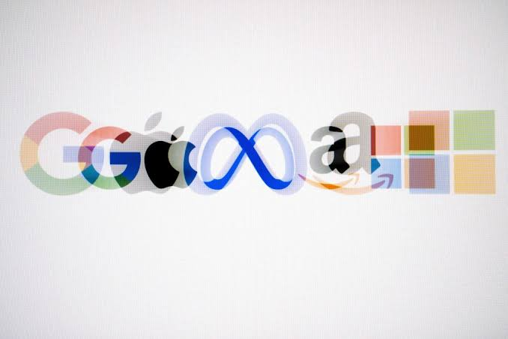
Algorithm and deployment:
For logo design using generative artificial intelligence, one commonly used algorithm is Generative Adversarial Networks (GANs).
GANs consist of two neural networks, a generator and a discriminator, which work in tandem to generate realistic and diverse logo designs
As for deployment, a cloud-based solution is often preferred for scalability and accessibility. Cloud platforms such as Amazon Web Services (AWS), Microsoft Azure, or Google Cloud
Platform (GCP) provide the infrastructure needed to deploy and serve the AI model. By deploying the model on the cloud, users can access it remotely through APIs or web interfaces, making it easier to generate logo designs from anywhere with an internet connection.
Additionally, cloud deployment allows for efficient scaling to accommodate varying levels of demand and usage.

Slide 13
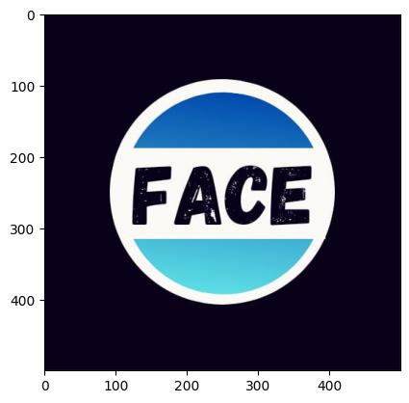
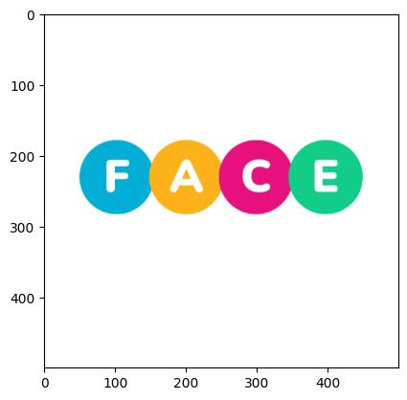
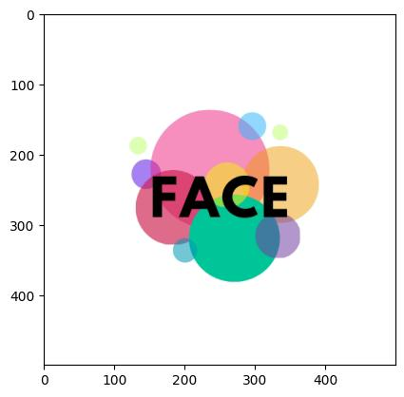
RESULT :
Using generative artificial intelligence for logo design can yield a wide range of diverse and customizable designs, ranging from minimalist to intricate styles. This approach streamlines the design process, allowing for quick exploration of new concepts and efficient iteration based on client feedback.

Slide 14
Reference
https://colab.research.google.com/drive/1Lj3t5zaqwNDrVg6DUPzm16E5Li9xSXSG
https://www.google.com/url?sa=t&source=web&rct=j&opi=89978449&url=https://octane.stpi.in/uploads/files/SampleProblemStatement_Graphics.pdf&ved=2ahUKEwin9enq4aqFAxXgS2wGHS9hA-IQFnoECDwQAQ&usg=AOvVaw22AIV3Zdfx90FYr_RQGy9F
https://images.app.goo.gl/8En25jC13smHuL8a6
Dataset link
https://www.kaggle.com/datasets/kkhandekar/popular-brand-logos-image-dataset/code

Slide 15
CONCLUSION:
In conclusion, leveraging generative artificial intelligence for logo design offers a promising avenue for creating diverse and customizable designs efficiently. Through algorithms like Generative Adversarial Networks (GANs), AI models can produce a wide array of logo concepts, ranging from simple to intricate, while allowing for rapid iteration and exploration of new ideas. Cloud deployment further enhances scalability, enabling the handling of large volumes of design requests.

